Slide 1
PHARMACOGNOSY 3RD CLASS
EXTRACTION OF PIPERINE ALKALOID FROM BLACK PEPPER
By
Dr. Zainab Tuama

Slide 2
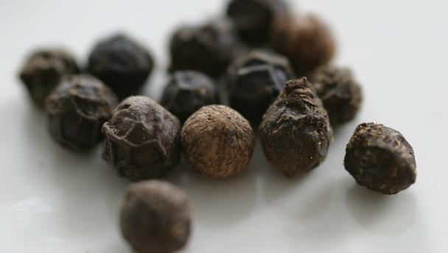
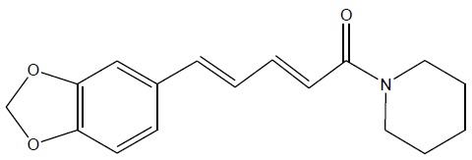
Piperine: - It is an alkaloid isolated from the plant (Piper nigrum). Piperine is responsible for the pungency of black pepper
Family: Piperaceae
Genus: Piper
Species: P. nigrum
Common name (black pepper)
Piperine properties
1. Molecular formula: C17H19NO3
2.Piperine Chemical Structure

Slide 3
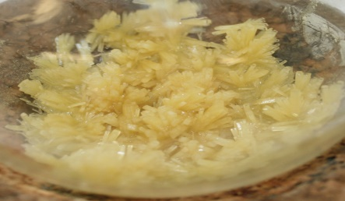
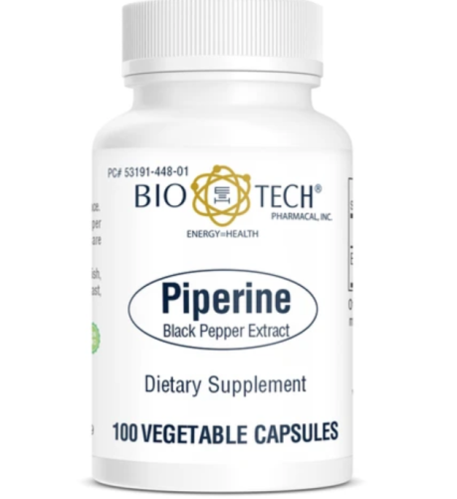
1.Slightly soluble in water and more soluble in alcohol, ether or chloroform.
2.Pure shape is yellow needle crystals
3.Present in plant as weak base
4.Piperine is hydrolysis in acidic or alkaline media to Piperidine and piperic acide in
the present of heating.
5. Piperine yield salt only with strong acid.
Piperine medicinal using
Supports digestive, natural antioxidant and immune health. Also play role as antihyperglycemic agents

Slide 4
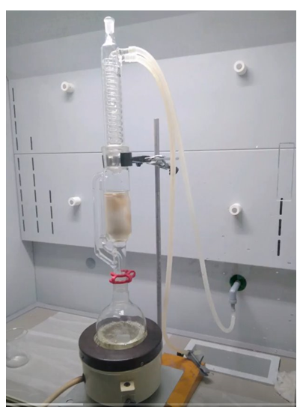
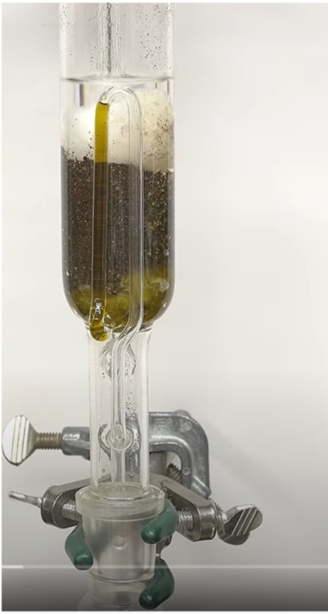
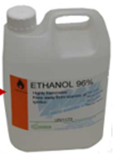
1)15 gm. of black pepper powder extracted with 150ml of 95% ethanol in Soxhlet extractor for 2h. ​
condenser
Extraction chamber
arm
Thimble
Boiling flask
Heater (hot plate)

Slide 6
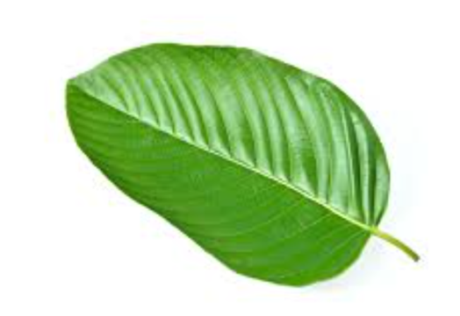
Methods for alkaloid extraction from plant
Base method
Acid method
Organic method
Base
Base
Salt
Salt
Salt
Salt
Base
Salt
Base
Salt

Slide 7
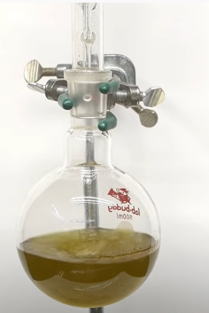
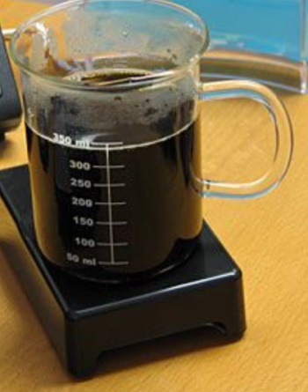
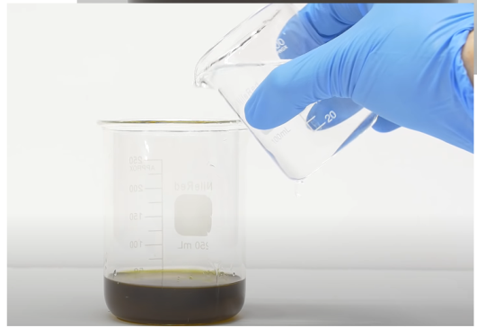
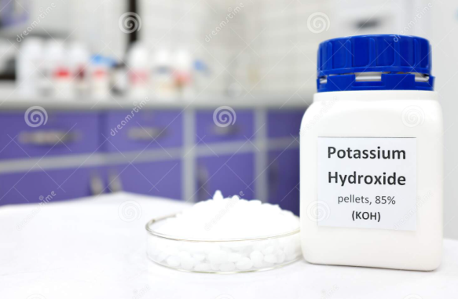
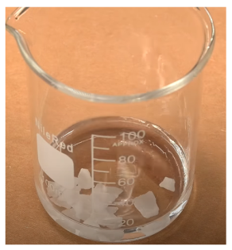
Reduce the volume of extract by evaporate the solution to 10 ml. ​
30ml
10% of alcoholic potassium hydroxide was added with continuous stirring for 10 min . ​
The solution is cooled ​

Slide 9
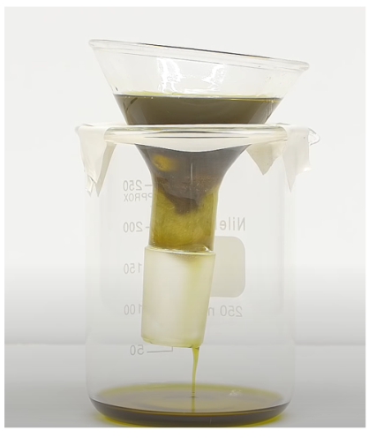
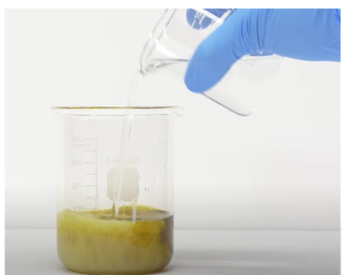
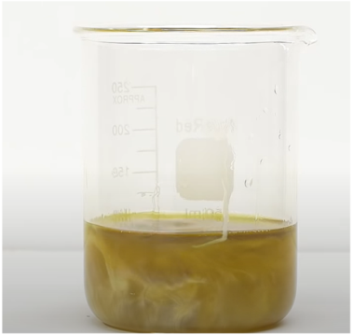
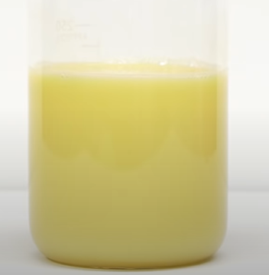
5. Filtration to remove insoluble residue.
Insoluble residue removed from extract
Why piperine precipitate?
6. D.W. add to solution in order to precipitate the piperine
Piperine soluble in ethanol (free base) + water (base)
ppt

Slide 10
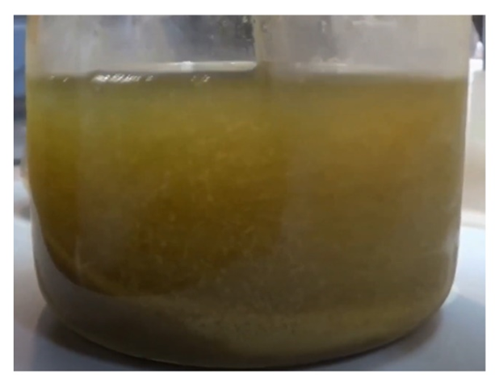
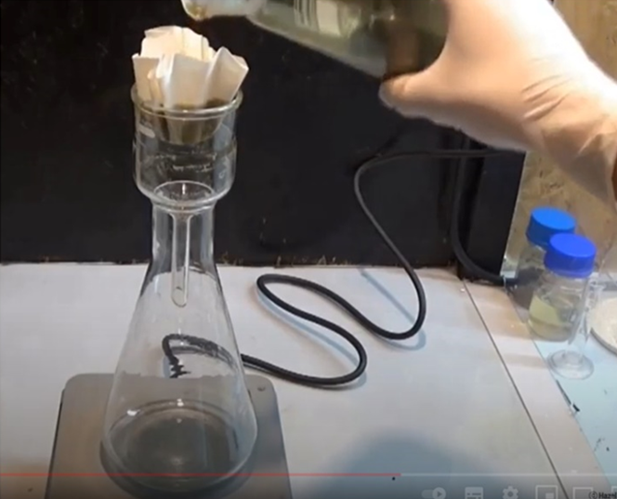
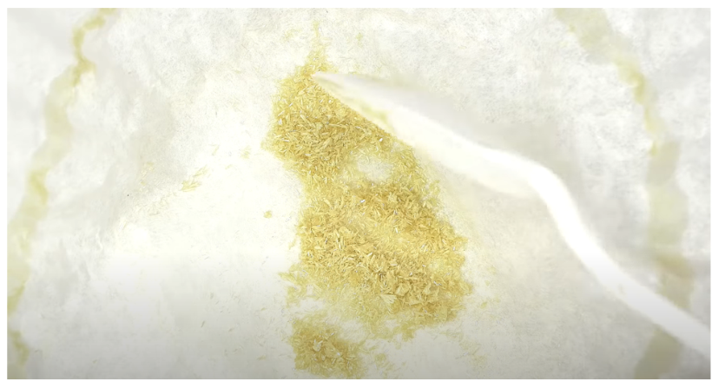
6. Cover the flask with Parafilm, label it, and allow the mixture to stand until the next lab period. Piperine will crystalize upon standing overnight. Isolate the yellow precipitate that has formed by filtration

Slide 12
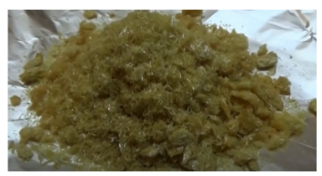
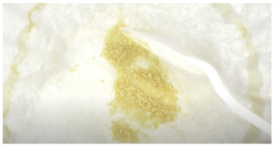
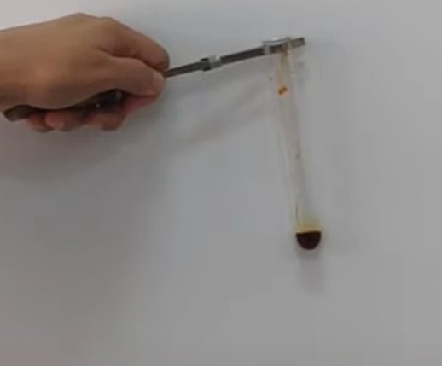
Identification of Piperine Alkaloid
1. Quantitative Analysis
This is performed by weighing the crystals of Piperine alkaloid
2. Qualitative Analysis:
Wagner’s Test :- Aim to indicate in general the alkaloid as
Procedure:
Take few crystals of Piperine alkaloid and dissolve in few ml of ethanol,
in test tube then add 2 drops of HCl.
Then add 2 drops of Wagner’s reagent Result : Brown precipitate formed

